Slide 1
Bloodstain Hyperspectral Image Classification Using Hybrid CNN
Course No : CSE-4206
Course Name : Seminar
Date : 24 November,2023
Presented By
Md Al Amin Tokder
Roll:1803078
Department of CSE, RUET
Supervised By
Tasmia Jannat
Lecturer
Department of CSE, RUET
Notes:
Are your classroom colors different than what you see in this template? That’s OK! Click on Design -> Variants (the down arrow) -> Pick the color scheme that works for you!
Feel free to change any “You will…” and “I will…” statements to ensure they align with your classroom procedures and rules!

Slide 2
Outline
Introduction
Motivation
Related Works
Dataset
Proposed Methodology
Future Work
Reference
Objectives
Roll : 1803078 “Bloodstain Hyperspectral Image Classification“

Slide 3
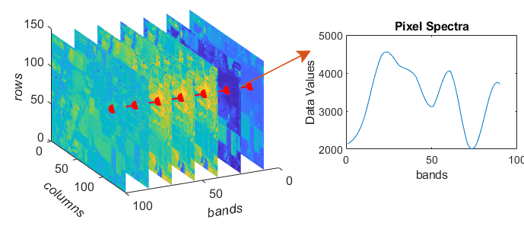
Introduction
Hyperspectral image involves capturing a large number of narrow and contiguous bands across the spectrum but traditional image, which captures three bands of information (red, green, and blue).
Provide high spectral and spatial resolution
Capture more detailed Information than normal images.
Figure-1 : Hyperspectral Image
Roll : 1803078 “Bloodstain Hyperspectral Image Classification using Hybrid CNN“

Slide 4
Motivation
Hyperspectral image capture high information
Provide details information of an image
Remote sensing ,agriculture ,medicine, blood
Analysis of bloodstain patterns , forensic investigation
Crime scene analysis
4
Roll : 1803078 “Bloodstain Hyperspectral Image Classification using Hybrid CNN“

Slide 5
Objective
To create a efficient method to identify substance classification in forensic science .
To get better accuracy
To capture both spectral and spatial information for analysis purpose
Dimensionality Reduction
5
Roll : 1803078 “Bloodstain Hyperspectral Image Classification using Hybrid CNN“

Slide 6
Related Works
Paper Title | Method Used | Limitation
“A Fast and Hybrid CNN for Hyperspectral Imaging-based Bloodstain Classification,” Forensic science international 2022 [1] | 1D,2D,3D Convolutional Neural Network | Accuracy = 95% Use PCA only for feature extraction
"Hyperspectral imaging for non-contact analysis of forensic traces,” Journal of Multidisciplinary Research at Trent 2019 [2] | Uses correlation coefficient in the visible region using reflectance spectroscopy to identify blood. | No use of Deep learning
“Blood stain classification with hyperspectral imaging and deep neural networks,” Science & Justice 2021 [3] | Multilayer Perceptron, Deep Recurrent Neural Network, | Use only one method (PCA) for feature extraction
Roll : 1803078 “Bloodstain Hyperspectral Image Classification“

Slide 7
Problem Statement
Need Efficient feature extraction technique
Need a custom model for better accuracy
Forensic investigations heavily rely on the identification and classification of bloodstains
Traditional methods for bloodstain analysis in forensic science face limitations in terms of accuracy and efficiency.
Roll : 1803078 “Bloodstain Hyperspectral Image Classification“

Slide 8
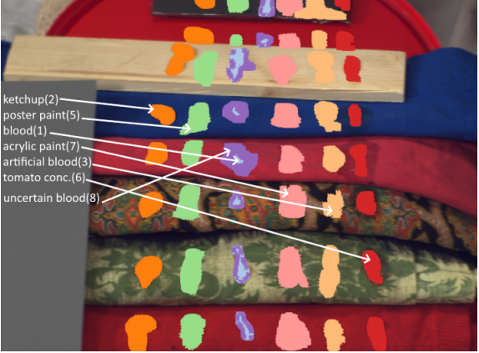
Dataset
The dataset is called “Hyperblood“ Hyperspectral-based Bloodstain dataset.
This dataset has different types of substances i.e., blood and blood-like compounds, for instance, ketchup, artificial blood, beetroot juice, poster paint, tomato concentrate, acrylic paint, uncertain blood.[1]
Dataset contains : 14 hyperspectral images (ENVI format)
Image size : 519 x 696 pixels (each pixel contains 113 band)
Number of Class : 7
Source : www.kaggle.com
Roll : 1803078 “Bloodstain Hyperspectral Image Classification“

Slide 9
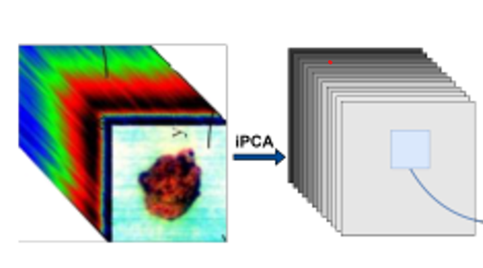
Proposed Methodology
Ketchup
3D convolution
Artificial Blood
2D convolution
Poster paint
I
Blood
Acrylic pain
IPCA
KPCA
Tomato concentrate
Uncertain blood
Spectral-Spatial
feature learning
Spatial feature
Fully connected
layer
Output classification
Figure-2: Proposed Hybrid CNN Model

Slide 10
Future Work
Implement the proposed model
Optimize and modify in the convolutional layer
Apply different feature extraction method for better accuracy
Use different activation function like Mish , ReLU
Roll : 1803078 “Bloodstain Hyperspectral Image Classification“

Slide 11
References
[1] Muhammad Ahmad, Jian Ping Li ,Ramil Kuleev, Muhammad Hassaan Farooq Butt, “A Fast and Hybrid CNN for Hyperspectral Imaging-based Bloodstain Classification”. Forensic science international, vol. 223, no. 1-3, pp. 28–39, 2022
[2] G. Edelman, E. Gaston, T. Van Leeuwen, P. Cullen, and M. Aalders,“Hyperspectral imaging for non-contact analysis of forensic traces,” Forensic science international, vol. 223, no. 1-3, pp. 28–39, 2021
[3] S. Cadd, B. Li, P. Beveridge, W. T. O’Hare, A. Campbell, and M. Islam, “The non-contact detection and identification of blood stained fingerprints using visible wavelength hyperspectral imaging: Part iieffectiveness on a range of substrates,” Science & Justice, vol. 56, no. 3, pp. 191–200, 2016.
[4] B. Li, P. Beveridge, W. T. O’Hare, and M. Islam, “The application of visible wavelength reflectance hyperspectral imaging for the detection and identification of blood stains,” Science & justice, vol. 54, no. 6, pp.
432–438, 2014.
Roll : 1803078 “Bloodstain Hyperspectral Image Classification“

Slide 12
References
[5] R. Schalike and M. Illes, “A review of spectroscopic methods applied to bloodstain pattern analysis,” Journal of Multidisciplinary Research at Trent, vol. 2, no. 1, pp. 90–104, 2019.
Roll : 1803078 “Bloodstain Hyperspectral Image Classification“

Slide 13
Thank You

